Slide 1
Lesson 4
SHARE

Slide 2
Abstinence
WCSD Definition
  Sexual Abstinence is defined as refraining from all forms of sex and genital contact such as vaginal, oral and anal sex.
  An abstinent person is someone who has either never had sex or someone who’s had sex but who has decided not to continue having sex for a period of time.
  Abstinence is the only 100% effective way to prevent HIV, other sexually transmitted diseases or infections and pregnancy.
    SEX-when a person’s genitals touch another person’s genitals, mouth or anus.

Slide 3
Which Contraception is right for me
Consent Comes First!

Slide 4
Contraception at a Glance
Review contraceptives with the following link:
  https://www.your-life.com/en/contraception-methods/#methods-

Slide 5
Charlie
Charlie has always been the most organized person in her group of
friends. She never turns in her school assignments late and loves to have
a full but predictable schedule. Lately, her acne has gotten really bad, so
her Mom took her to the dermatologist. So far, the medicine they’ve tried
hasn’t really worked.
Issue- Doesn’t feel comfortable touching her genitals

Slide 6
Marcus
Marcus is a really hard worker and in the top 10th percentile in the junior
class. He is also really cute, but super shy and hasn’t had a serious
relationship yet. He hooked up one time and had oral sex, but got his heart
broken so he’s been hesitant to put himself out there again. Marcus knows
there will be a big party after the home game tonight and he hopes the
person he’s been crushing on for a while will be there too so he can make
a move. He wants to be ready just in case things go well and he hopes he
doesn’t chicken out from talking to them.
Issue: Embarrassed to go to the store to buy condoms

Slide 7
Marissa
Marissa is someone who always sees the best in people. She is pretty
happy most of the time except for when she gets her periods. She gets
really bad cramps and a super heavy period and sometimes even has to
stay home from school because her period is so bad. Otherwise, Marissa
loves to be carefree and spontaneous and feels that getting pregnant now
would really affect her future. She’s not with anyone right now and is fine
with that, since she has such a great group of friends.
Issue: Doesn’t have transportation

Slide 8
Where are contraceptives available?
Washoe County District Health-Teen Health Mall
Northern Nevada Hopes
Community Health Alliance
Planned Parenthood
Doctors office/clinic
Renown Women’s Health Clinic @ Ryland (formerly The Pregnancy Center)

Slide 9
Effective Condom use

Slide 10
What do you know about condoms?
They protect against pregnancy and STDs
They come in different sizes
You can get them for free
97% Effective- If used correctly and with every sex act that involves a penis. They are effective at preventing pregnancy and most STDs, including HIV-the virus that causes AIDS.
A responsible condom user should check for breakage with each use.

Slide 11

How To Put on a Male Condom
Take out of package
Right Way- rolls easy. Rolled rim on outside
Pinch the entire reservoir at the tip of the condom shut
Roll down to base of the penis
Apply lubricant-water or silicone-based lubes only
After ejaculation HOLD ONTO RIM AND WITHDRAW
Remove the condom after ejaculation
Throw away in the garbage. Don’t flush it.
DO NOT REUSE!!!

Slide 12
Things to Remember
Give and obtain CONSENT before having sex
  Lack of a “NO” does not mean “Yes”
Have more than one condom
Check the expiration date
Carefully open the condom. NO TEETH or SCISSORS
Check whether it’s right side up
YOU CANNOT RE-USE A CONDOM!!!!
*Do not store in wallet or car*
Notes:
* The heat in the wallet and car, can wear a condom down. Only place in wallet if intending to use within the day.

Slide 13
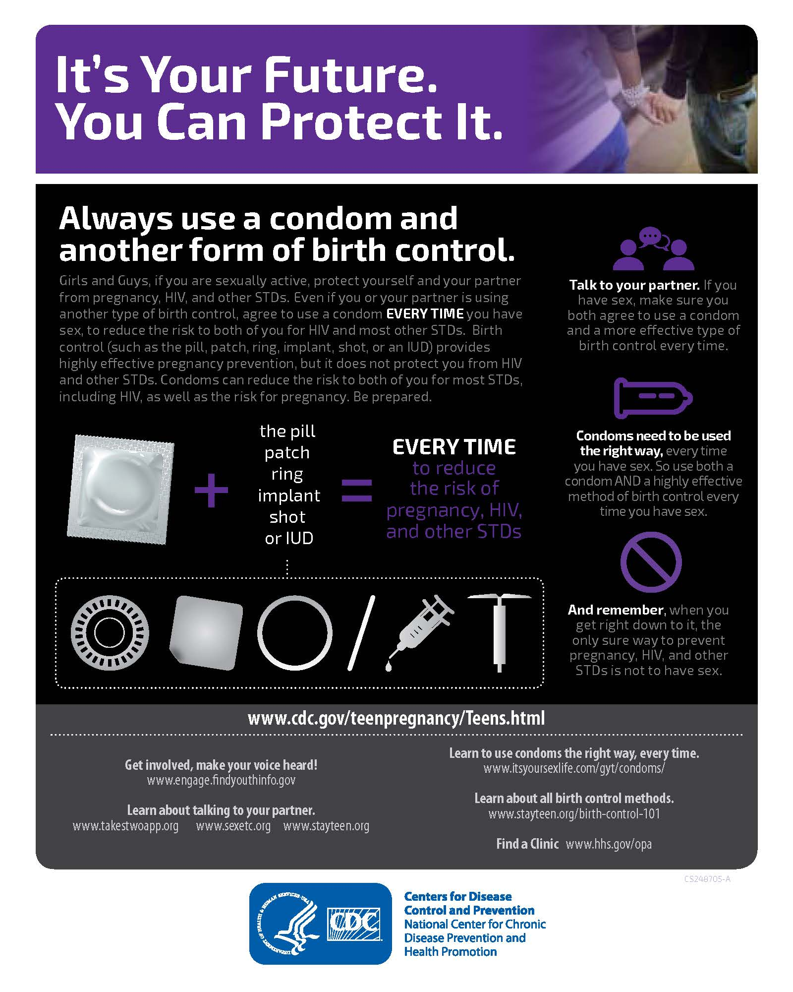

Slide 14
Reproductive Rights

Slide 15
What are Amanda’s Rights?
Amanda is 14 and pregnant. Amanda's mother and father know about the pregnancy and are wiling to support her, as does her boyfriend, Daniel, who is 16 and wants to be an active part in this baby’s life. His parents are equally as supportive as Amanda’s. Amanda’s PE teacher tells her she cannot be a part of class because he is concerned about how exercise will affect the pregnancy. Instead, Amanda is instructed to sit in the gym and do homework. Amanda was also recently told by the assistant principal that if she continues missing school due to her pregnancy, she will be suspended and could even be required to repeat that year of school. Amanda has tried to explain that her pregnancy is challenging, and brings in doctors’ notes every time she has an appointment.

Slide 16
What are Amanda’s Rights?
What are Amanda’s rights in this situation? Does the state she live in matter?
Is the school right to be concerned about her safety?
Should she be shown special treatment because she is pregnant?
https:/nwlc.org/issue/pregnant-parenting-students//
https://nwlc-ciw49tixgw5lbab.stackpathdns.com/wp-content/uploads/2016/08/Final_Aug2016_nwlc_PPToolkit.pdf

Slide 17
What are Damien and Linda’s Rights?
Damien and Linda are both 16 and live in Nevada. Linda gets pregnant, decides she is too young to be a parent, and doesn’t want to carry a pregnancy to term if she’s not going to parent the baby. She doesn’t want to place the baby for adoption because she doesn’t think she’d be able to deal with knowing that her baby was out there if she isn’t going to raise it. Damien is really against abortion and tells her he’d raise the baby if she didn’t want to; she refuses. Things get heated, and they break up.

Slide 18
What are Damien and Linda’s Rights?
What are Damien’s rights as the person involved in the creation of the pregnancy?
Can he stop Linda from having an abortion?
What does Linda need to do in order to get an abortion in Nevada?
How soon does Linda have to decide whether or not to have an abortion?
If Linda chooses to place the baby for adoption, can Damien stop her so he can raise the baby?
https://www.guttmacher.org/state-policy/explore/overview-abortion-laws
https://healthfully.com/192030-fathers-rights-in-teen-pregnancy.html

Slide 19
Teen Pregnancy Options

Slide 20
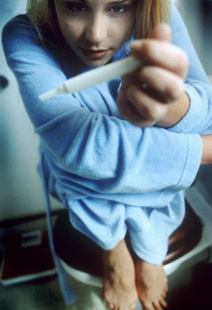
TEEN PREGNANCY CHOICES
Statistics
Parenthood
  6 out of 10 will keep the baby
Adoption
  1 out of 10 teen mothers will place the baby up for adoption
Abortion
  3 out of 10 teen mothers will have an abortion
https://www.acog.org/Patients/FAQs/Pregnancy-Choices-Raising-the-Baby-Adoption-and-Abortion?IsMobileSet=false

Slide 21
Resources for support
Washoe County Health District: https://www.washoecounty.us/health/programs-and-services/cchs/sexual_health_program/index.php
Renown Women’s Health Clinic @ Ryland: https://www.renown.org/locations/womens-health/ryland/
Casa da Vida: https://casadevidareno.org/
Northern Nevada Hopes: https://www.nnhopes.org/about/teen-health-resources/
Parent
Trusted adult
School counselor
School nurse
School social worker
Faith based leader
Medical provider

Slide 22
Adoption Types
Closed
Open
Adopting Parents/Placing Parents never meet and know nothing or very little about one another
File may be Sealed or Open
Child, once turns legal age, can reunite with biological parents.
Sharing of information and/or contact between the adoptive and biological parents of an adopted child
This can occur before, during and/or after the placement of the child
Semi-Open
Birth mother with information about the baby from the adoptive parents and vice versa
There is no direct contact between birth mother and the baby.
Identities are usually kept hidden.

Slide 23

ADOPTION-SAFE HAVEN
Nevada law (NRS 432B.630) states that a birth parent (mother or father) may leave their newborn, 30 days old or younger who does not appear to be abused or neglected, at a designated Safe Haven location.
Locations include Local Hospitals, Urgent Care Facilities, any Manned Fire or Police Station
Call 9-1-1 or 1-800-992-5757
Is not required to provide any identifying information, background information or a medical history, but may do so voluntarily.
Notes:
http://www.safehavennv.org/parents/processsteps/
give any identifying information, but may do so voluntarily.
Steps to surrender your baby
A parent must personally surrender the baby in one of two ways:
Physically hand the baby to one of the employees at a Safe Haven location, or
Place the baby in a safe place at the Safe Haven location, and immediately call the Safe Haven location or 911 to describe where the baby was left. NOTE: Nevada law* states that if an unattended baby is harmed or injured, the Safe Haven provider is not liable for any civil damages:
After the baby has been left on the property and before the provider is informed of the delivery and location of the baby, or
Before the provider takes physical possession of the baby.

Slide 24
ABORTION-COST
1st Trimester up to Week 12 $ 740
Week 13-14 (2 Day) $1540
Week 15-16 (2 Day) $1640
Week 17 (2 Day) $1740
Week 18 (2 Day) $1840
(No Abortions Performed After this Time)
These are the costs at a local clinic in Reno. Payment must be made in cash.
There is only one local clinic which provides surgical abortions.
Notes:
If a patient has the means to travel, there are other options.

Slide 25
Medical (Medication) Abortion
Clinic or Doctor’s office
Combination of Mifepristone and Misoprostol Medication
  Mifepristone: stops the pregnancy
  Misoprostol: causes the uterus to evacuate it’s contents
Medical (Medication) Abortions accounted for 1/3 of all abortions
Can be taken under supervision up to 70 days after the first day of the last menstrual period. May still need Medical Procedure.
Must GO BACK TO DOCTOR FOR CHECKUP
Cost ranges from $300-$800
Patient will experience:
  Bleeding
  Cramping
  Change in hormone levels
https://www.guttmacher.org/evidence-you-can-use/medication-abortion
Notes:
Hormonal methods of contraception, including the morning-after pill, prevent pregnancy by inhibiting ovulation and fertilization (ACOG, 1998). The abortion pill ends a pregnancy without using instruments. By helping women terminate unwanted pregnancies up to 70 days after their last menstruation, the abortion pill is a safe and effective option.
The difference between the “Morning After Pill” and the “Abortion Pill”: https://www.plannedparenthood.org/files/3914/6012/8466/Difference_Between_the_Morning-After_Pill_and_the_Abortion_Pill.pdf

Slide 26
Talk to someone!

